Slide 1

Chapter 3 – Implementing Classes

Slide 2
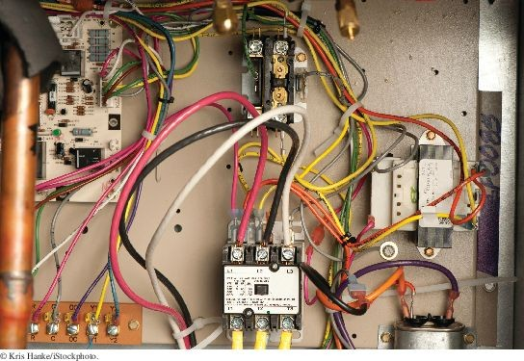
Chapter Goals
To become familiar with the process of implementing classes
To be able to implement and test simple methods
To understand the purpose and use of constructors
To understand how to access instance variables and local variables
To be able to write javadoc comments
To implement classes for drawing graphical shapes

Slide 3

Instance Variables and Encapsulation
Figure 1 Tally counter
Simulator statements:
Counter tally = new Counter(); tally.click();
tally.click();
int result = tally.getValue(); // Sets result to 2
Each counter needs to store a variable that keeps track of the number of simulated button clicks.

Slide 4
Instance Variables
Instance variables store the data of an object.
Instance of a class: an object of the class.
An instance variable is a storage location present in each object of the class.
The class declaration specifies the instance variables:
public class Counter
{
private int value;
...
}
An object's instance variables store the data required for executing its methods.

Slide 5
Instance Variables
An instance variable declaration consists of the following parts:
access specifier (private) type of variable (such as int)
name of variable (such as value)
You should declare all instance variables as private.

Slide 6
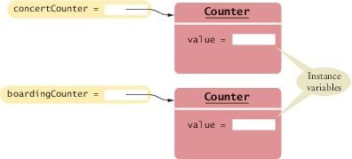
Instance Variables
Each object of a class has its own set of instance variables.
Figure 2 Instance Variables

Slide 7
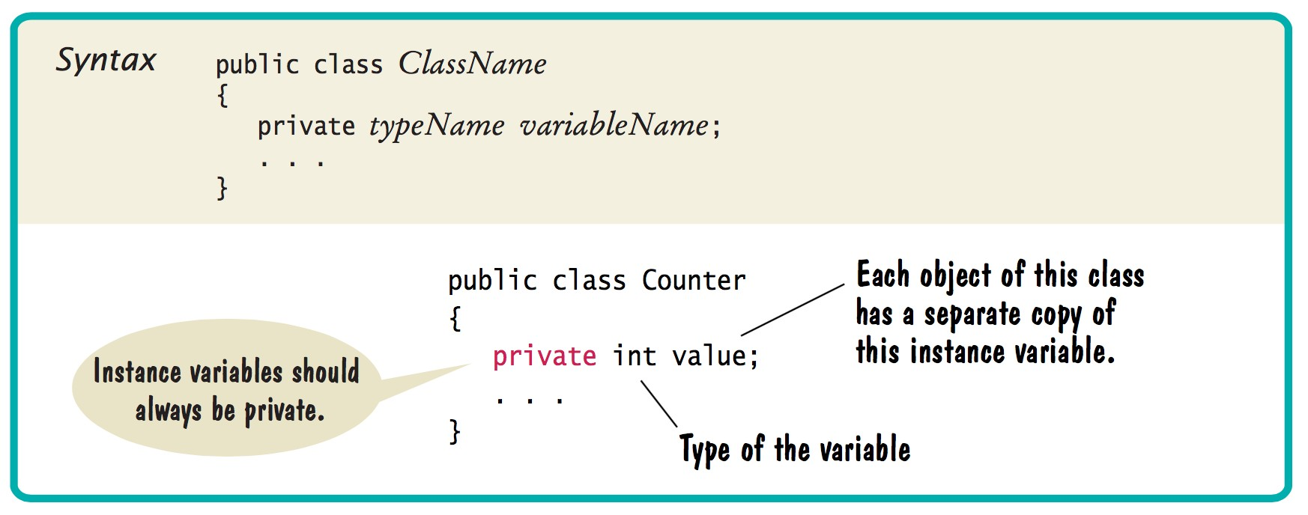
Syntax 3.1 Instance Variable Declaration

Slide 8

Instance Variables
These clocks have common behavior, but each of them has a different state. Similarly, objects of a class can have their instance variables set to different values.

Slide 9
The Methods of the Counter Class
The click method advances the counter value by 1:
public void click()
{
value = value + 1;
}
Affects the value of the instance variable of the object on which the method is invoked
The method call concertCounter.click();
Advances the value variable of the concertCounter object

Slide 10
The Methods of the Counter Class
The getValue method returns the current value:
The return statement
Terminates the method call
Returns a result (the return value) to the method's caller
Private instance variables can only be accessed by methods of the same class.
public int getValue()
{
return value;
}

Slide 11
Encapsulation
Encapsulation is the process of hiding implementation details and providing methods for data access.
To encapsulate data:
Declare instance variables as private and Declare public methods that access the variables
Encapsulation allows a programmer to use a class without having to know its implementation.
Information hiding makes it simpler for the implementor of a class to locate errors and change implementations.

Slide 12

Encapsulation
A thermostat functions as a "black box" whose inner workings are hidden.
When you assemble classes, like Rectangle and String, into programs you are like a contractor installing a thermostat.
When you implement your own classes you are like the manufacturer who puts together a thermostat out of parts.

Slide 13
section_1/Counter.java
1 /**
2 This class models a tally counter.
3 */
4 public class Counter
5 {
6 private int value;
7
8 /**
9 Gets the current value of this counter.
10 @return the current value
11 */
12 public int getValue()
13 {
14 return value;
15 }
16
17 /**
18 Advances the value of this counter by 1.
19 */
20 public void click()
21 {
22 value = value + 1;
23 }
24
25 /**
26 Resets the value of this counter to 0.
27 */
28 public void reset()
29 {
30 value = 0;
31 }
32 }

Slide 14
Self Check 3.1
Supply the body of a method public void unclick() that undoes an unwanted button click.
Answer:
public void unclick()
{
value = value - 1;
}

Slide 15
Self Check 3.2
Suppose you use a class Clock with private instance variables hours and minutes. How can you access these variables in your program?
Answer: You can only access them by invoking the methods of the Clock class.

Slide 16
Self Check 3.3
Consider the Counter class. A counter’s value starts at 0 and is advanced by the click method, so it should never be negative. Suppose you found a negative value variable during testing. Where would you look for the error?
Answer: In one of the methods of the Counter class.

Slide 17
Self Check 3.4
In Chapters 1 and 2, you used System.out as a black box to cause output to appear on the screen. Who designed and implemented System.out?
Answer: The programmers who designed and implemented the Java library.

Slide 18
Self Check 3.5
Suppose you are working in a company that produces personal finance software. You are asked to design and implement a class for representing bank accounts. Who will be the users of your class?
Answer: Other programmers who work on the personal finance application.

Slide 19
Specifying the Public Interface of a Class
In order to implement a class, you first need to know which methods are required.
Essential behavior of a bank account:
deposit money withdraw money get balance

Slide 20
Specifying the Public Interface of a Class
Here are the method headers needed for a BankAccount class:
public void deposit(double amount) public void withdraw(double amount) public double getBalance()
We want to support method calls such as the following:
harrysChecking.deposit(2000); harrysChecking.withdraw(500); System.out.println(harrysChecking.getBalance());

Slide 21
Specifying the Public Interface of a Class: Method Declaration
A method's body consisting of statements that are executed when the method is called:
public void deposit(double amount)
{
implementation - filled in later
}
You can fill in the method body so it compiles:
public double getBalance()
{
// TODO: fill in implementation return 0;
}

Slide 22
Specifying the Public Interface of a Class
BankAccount methods were declared as public.
public methods can be called by all other methods in the program.
Methods can also be declared private
private methods only be called by other methods in the same class
private methods are not part of the public interface

Slide 23
Specifying Constructors
Initialize objects
Set the initial data for objects
Similar to a method with two differences:
The name of the constructor is always the same as the name of the class Constructors have no return type

Slide 24
Specifying Constructors: BankAccount
Two constructors
public BankAccount()
public BankAccount(double initialBalance)
Usage
BankAccount harrysChecking = new BankAccount(); BankAccount momsSavings = new BankAccount(5000);

Slide 25
Specifying Constructors: BankAccount
The constructor name is always the same as the class name. The compiler can tell them apart because they take different arguments.
A constructor that takes no arguments is called a no-argument constructor.
BankAccount's no-argument constructor - header and body:
public BankAccount()
{
constructor body—implementation filled in later
}
The statements in the constructor body will set the instance variables of the object.

Slide 26
BankAccount Public Interface
The constructors and methods of a class go inside the class declaration:
public class BankAccount
{
// private instance variables--filled in later
// Constructors public BankAccount()
{
// body--filled in later
}
public BankAccount(double initialBalance)
{
// body--filled in later
}
// Methods
public void deposit(double amount)
{
// body--filled in later
}
public void withdraw(double amount)
{
// body--filled in later
}
public double getBalance()
{
// body--filled in later
}
}

Slide 27
Specifying the Public Interface of a Class
public constructors and methods of a class form the public interface of the class.
These are the operations that any programmer can use

Slide 28
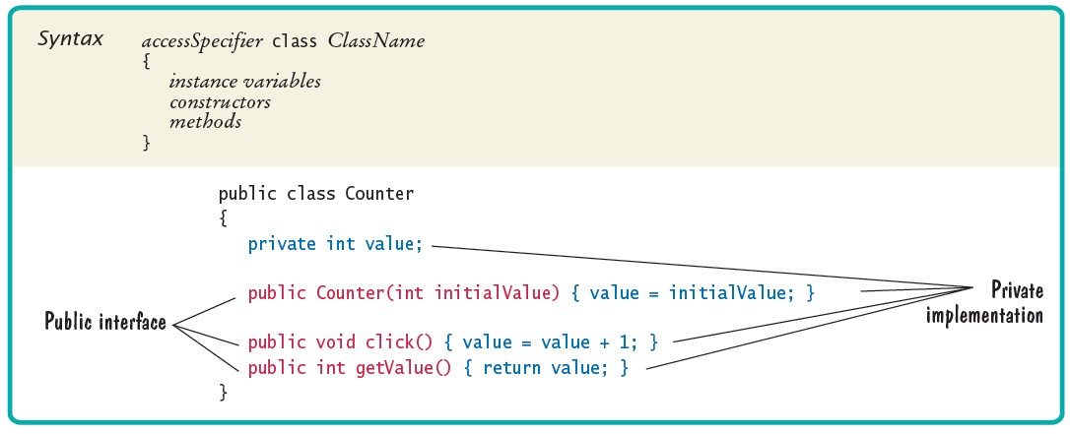
Syntax 3.2 Class Declaration

Slide 29
Using the Public Interface
Example: transfer money
// Transfer from one account to another double transferAmount = 500; momsSavings.withdraw(transferAmount); harrysChecking.deposit(transferAmount)
Example: add interest
double interestRate = 5; // 5 percent interest
double interestAmount = momsSavings.getBalance() * interestRate / 100; momsSavings.deposit(interestAmount);
Programmers use objects of the BankAccount class to carry out meaningful tasks
without knowing how the BankAccount objects store their data without knowing how the BankAccount methods do their work

Slide 30
Commenting the Public Interface
Use documentation comments to describe the classes and public methods of your programs.
Java has a standard form for documentation comments.
A program called javadoc can automatically generate a set of HTML pages.
Documentation comment
placed before the class or method declaration that is being documented

Slide 31
Commenting the Public Interface - Documenting a method
Start the comment with a /**. Describe the method’s purpose. Describe each parameter:
start with @param
name of the parameter that holds the argument a short explanation of the argument
Describe the return value:
start with @return
describe the return value
Omit @param tag for methods that have no arguments.
Omit the @return tag for methods whose return type is void. End with */

Slide 32
Commenting the Public Interface - Documenting a method
Example:
/**
Withdraws money from the bank account.
@param amount the amount to withdraw
*/
public void withdraw(double amount)
{
implementation—filled in later
}
Example:
/**
Gets the current balance of the bank account.
@return the current balance
*/
public double getBalance()
{
implementation—filled in later
}

Slide 33
Commenting the Public Interface - Documenting a class
Place above the class declaration.
Supply a brief comment explaining the class's purpose. Example:
/**
A bank account has a balance that can be changed by deposits and withdrawals.
*/
public class BankAccount
{
. . .
}
Provide documentation comments for:
every class every method
every parameter variable every return value

Slide 34
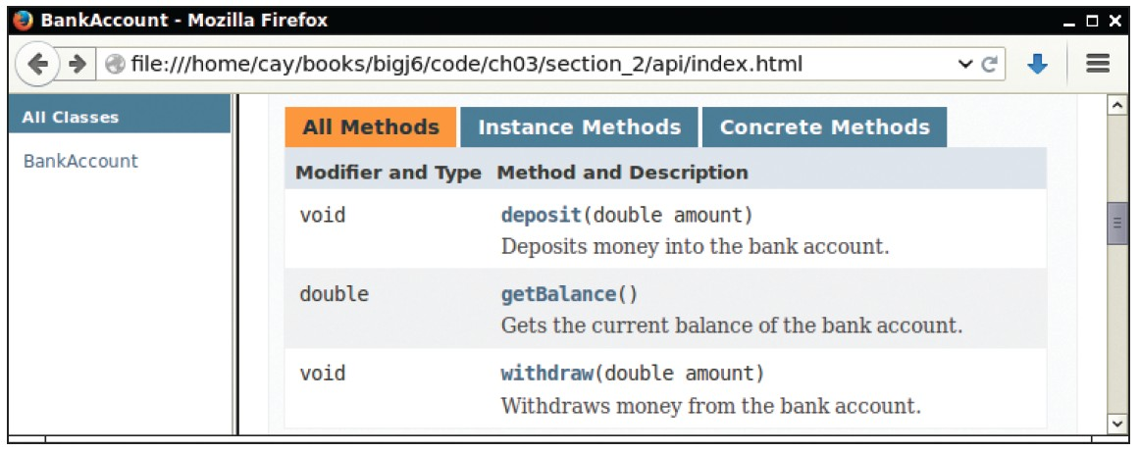
Method Summary
Figure 3 A Method Summary Generated by javadoc

Slide 35
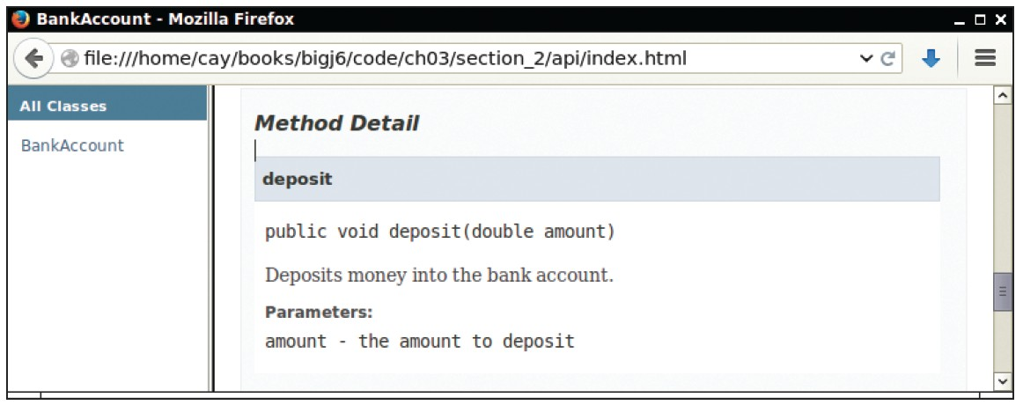
Method Details
Figure 4 Method Detail Generated by javadoc

Slide 36
Self Check 3.6
How can you use the methods of the public interface to empty the harrysChecking
bank account?
Answer:
harrysChecking.withdraw(harrysChecking.getBalance())

Slide 37
Self Check 3.7
What is wrong with this sequence of statements?
BankAccount harrysChecking = new BankAccount(10000); System.out.println(harrysChecking.withdraw(500));
Answer: The withdraw method has return type void. It doesn’t return a value. Use the getBalance method to obtain the balance after the withdrawal.

Slide 38
Self Check 3.8
Suppose you want a more powerful bank account abstraction that keeps track of an account number in addition to the balance. How would you change the public interface to accommodate this enhancement?
Answer: Add an accountNumber parameter to the constructors, and add a getAccountNumber method. There is no need for a setAccountNumber method – the account number never changes after construction.

Slide 39
Self Check 3.9
Suppose we enhance the BankAccount class so that each account has an account number. Supply a documentation comment for the constructor
public BankAccount(int accountNumber, double initialBalance)
Answer:
/**
Constructs a new bank account with a given initial balance.
@param accountNumber the account number for this account
@param initialBalance the initial balance for this account
*/

Slide 40
Self Check 3.10
Why is the following documentation comment questionable?
/**
Each account has an account number.
@return the account number of this account
*/
public int getAccountNumber()
Answer: The first sentence of the method description should describe the method—it is displayed in isolation in the summary table.

Slide 41
Providing the Class Implementation
The private implementation of a class consists of:
instance variables
the bodies of constructors the bodies of methods.

Slide 42
Providing Instance Variables
Determine the data that each bank account object contains.
What does the object need to remember so that it can carry out its methods?
Each bank account object only needs to store the current balance.
BankAccount instance variable declaration:
public class BankAccount
{
private double balance;
// Methods and constructors below
. . .
}

Slide 43

Providing Instance Variables
Like a wilderness explorer who needs to carry all items that may be needed, an object needs to store the data required for its method calls.

Slide 44
Providing Constructors
Constructor's job is to initialize the instance variables of the object. The no-argument constructor sets the balance to zero.
public BankAccount()
{
balance = 0;
}
The second constructor sets the balance to the value supplied as the construction argument.
public BankAccount(double initialBalance)
{
balance = initialBalance;
}

Slide 45
Providing Constructors - Tracing the Statement
Create a new object of type BankAccount.
Call the second constructor
because an argument is supplied in the constructor call
Set the parameter variable initialBalance to 1000.
Set the balance instance variable of the newly created object to
initialBalance.
Return an object reference, that is, the memory location of the object.
Store that object reference in the harrysChecking variable.
Steps carried out when the following statement is executed:
BankAccount harrysChecking = new BankAccount(1000);

Slide 46
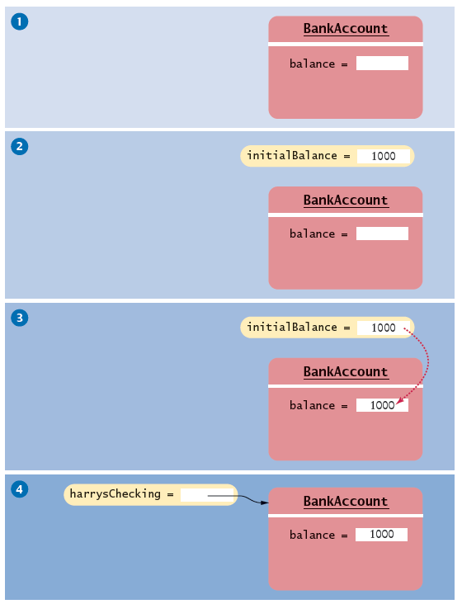
Providing Constructors - Tracing the Statement
Figure 5 How a Constructor Works

Slide 47

Providing Constructors
A constructor is like a set of assembly instructions for an object.

Slide 48
Providing Methods
Is the method an accessor or a mutator
Mutator method
Update the instance variables in some way
Accessor method
Retrieves or computes a result
deposit method - a mutator method
Updates the balance
public void deposit(double amount)
{
balance = balance + amount;
}

Slide 49
Providing Methods - continued
withdraw method - another mutator
public void withdraw(double amount)
{
balance = balance - amount;
}
getBalance method - an accessor method
Returns a value
public double getBalance()
{
return balance;
}

Slide 50
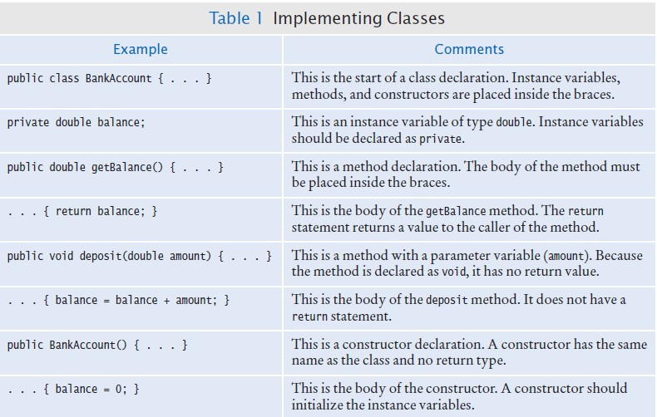
Table 1 Implementing Classes

Slide 51
section_3/BankAccount.java
1 | import java.awt.Graphics2D;
2 | import java.awt.Rectangle;
3 | import java.awt.geom.Ellipse2D;
4 | import java.awt.geom.Line2D;
5 | import java.awt.geom.Point2D;
6
7 | /**
8 | A car shape that can be positioned anywhere on the screen.
9 | */
10 | public class Car
11 | {
12 | private int xLeft;
13 | private int yTop;
14
15 | /**
16 | Constructs a car with a given top left corner.
17 | @param x the x coordinate of the top left corner
18 | @param y the y coordinate of the top left corner
19 | */
20 | public Car(int x, int y)
21 | {
22 | xLeft = x;
23 | yTop = y;
24 | }
25
26 | /**
27 | Draws the car.
28 | @param g2 the graphics context
29 | */
30 | public void draw(Graphics2D g2)
31 | {
32 | Rectangle body = new Rectangle(xLeft, yTop + 10, | 60, 10);
33 | Ellipse2D.Double frontTire
34 | = new Ellipse2D.Double(xLeft + 10, yTop + 20, | 10, 10);
35 | Ellipse2D.Double rearTire

Slide 52
Self Check 3.11
Suppose we modify the BankAccount class so that each bank account has an account number. How does this change affect the instance variables?
Answer: An instance variable needs to be added to the class:
private int accountNumber;

Slide 53
Self Check 3.12
Why does the following code not succeed in robbing mom's bank account?
public class BankRobber
{
public static void main(String[] args)
{
BankAccount momsSavings = new BankAccount(1000); momsSavings.balance = 0;
}
}
Answer: Because the balance instance variable is accessed from the main method of BankRobber. The compiler will report an error because main is not a method of the BankAccount class and main has no access to BankAccount instance variables.

Slide 54
Self Check 3.13
The Rectangle class has four instance variables: x, y, width, and height. Give a possible implementation of the getWidth method.
Answer:
public int getWidth()
{
return width;
}

Slide 55
Self Check 3.14
Give a possible implementation of the translate method of the Rectangle class.
Answer: There is more than one correct answer. One possible implementation is as follows:
public void translate(int dx, int dy)
{
int newx = x + dx; x = newx;
int newy = y + dy; y = newy;
}

Slide 56
Unit Testing
BankAccount.java can not be executed:
It has no main method
Most classes do not have a main method
Before using BankAccount.java in a larger program:
You should test in isolation
Unit test: verifies that a class works correctly in isolation, outside a complete program.

Slide 57
Unit Testing
To test a class, either
use an environment for interactive testing, or write a tester class to execute test instructions.
Tester class: a class with a main method that contains statements to test another class.
Typically carries out the following steps:
Construct one or more objects of the class that is being tested
Invoke one or more methods
Print out one or more results
Print the expected results

Slide 58

Unit Testing
An engineer tests a part in isolation. This is an example of unit testing.

Slide 59
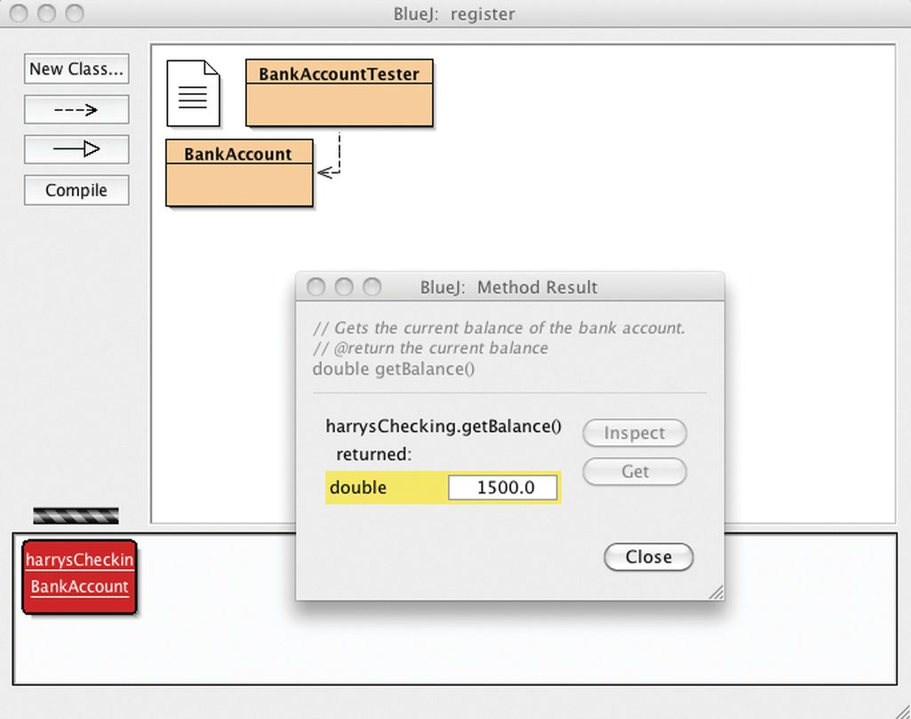
Unit Testing with Bluej
Figure 6 The Return Value of the getBalance Method in BlueJ

Slide 60
section_4/BankAccountTester.java
1 /**
2 A class to test the BankAccount class.
3 */
4 public class BankAccountTester
5 {
6 /**
Tests the methods of the BankAccount class.
@param args not used
9 */
10 public static void main(String[] args)
11 {
BankAccount harrysChecking = new BankAccount();
harrysChecking.deposit(2000);
harrysChecking.withdraw(500);
System.out.println(harrysChecking.getBalance());
System.out.println("Expected: 1500");
17 }
18 }
Program Run:
1500
Expected: 1500

Slide 61
Unit Testing - Building a program
To produce a program: combine both BankAccount and
BankAccountTester classes.
Details for building the program vary.
In most environments, you need to carry out these steps:
Make a new subfolder for your program
Make two files, one for each class
Compile both files
Run the test program
BankAccount and BankAccountTest have entirely different purposes:
BankAccount class describes objects that compute bank balances
BankAccountTester class runs tests that put a BankAccount object through its paces

Slide 62
Self Check 3.15
When you run the BankAccountTester program, how many objects of class
BankAccount are constructed? How many objects of type BankAccountTester?
Answer: One BankAccount object, no BankAccountTester object. The purpose of the BankAccountTester class is merely to hold the main method.

Slide 63
Self Check 3.16
Why is the BankAccountTester class unnecessary in development environments that allow interactive testing, such as BlueJ?
Answer: In those environments, you can issue interactive commands to construct BankAccount objects, invoke methods, and display their return values.

Slide 64
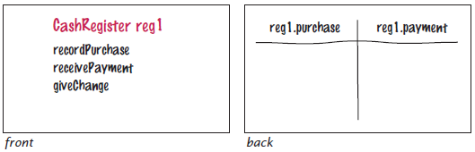
Problem Solving: Tracing Objects
Important skill: the ability to simulate the actions of a program with pencil and paper.
Use an index card or a sticky note for each object:
Write the methods on the front
Make a table for the values of the instance variables on the back
CashRegister class

Slide 65
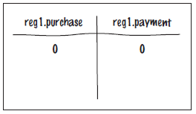
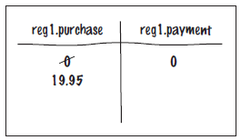
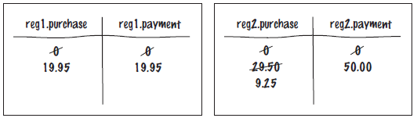
Problem Solving: Tracing Objects
When an object is constructed, fill in the initial values of the instance variables.
Update the values of the instance variables when a mutator method is called.
After a call to cashRegister's recordPurchase method
More than one object: create multiple cards

Slide 66
Problem Solving: Tracing Objects
Useful when enhancing a class..
Enhance CashRegister class to compute the sales tax.
Add methods recordTaxablePurchase and getSalesTax to the front of the card.
Don’t have enough information to compute sales tax:
need tax rate
need total of the taxable items
Need additional instance variables for:
taxRate taxablePurchase

Slide 67
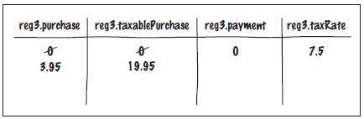
Problem Solving: Tracing Objects
Example: CashRegister class enhancement
The code:
CashRegister reg3(7.5); // 7.5 percent sales tax reg3.recordPurchase(3.95); // Not taxable reg3.recordTaxablePurchase(19.95); // Taxable
The card:

Slide 68
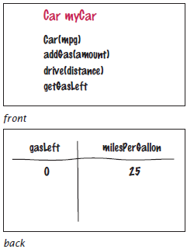
Self Check 3.17
Consider a Car class that simulates fuel consumption in a car. We will assume a fixed efficiency (in miles per gallon) that is supplied in the constructor. There are methods for adding gas, driving a given distance, and checking the amount of gas left in the tank.
Make a card for a Car object, choosing suitable instance variables and showing their
values after the object was constructed.
Answer:

Slide 69
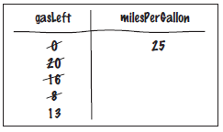
Self Check 3.18
Trace the following method calls:
Car myCar(25); myCar.addGas(20); myCar.drive(100); myCar.drive(200); myCar.addGas(5);
Answer:

Slide 70

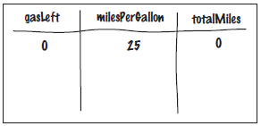
Self Check 3.19
Suppose you are asked to simulate the odometer of the car, by adding a method
getMilesDriven.
Add an instance variable to the object’s card that is suitable for computing this method’s result.
Answer:

Slide 71
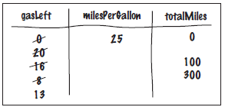
Self Check 3.20
Trace the methods of Self Check 18, updating the instance variable that you added in Self Check 19.
Answer:

Slide 72
Local Variables
Local variables are declared in the body of a method:
public double giveChange()
{
double change = payment - purchase; purchase = 0;
payment = 0; return change;
}
When a method exits, its local variables are removed.
Parameter variables are declared in the header of a method:
public void enterPayment(double amount)

Slide 73
Local Variables
Local and parameter variables belong to methods:
When a method runs, its local and parameter variables come to life When the method exits, they are removed immediately
Instance variables belong to objects, not methods:
When an object is constructed, its instance variables are created
The instance variables stay alive until no method uses the object any longer
Instance variables are initialized to a default value:
Numbers are initialized to 0
Object references are set to a special value called null
A null object reference refers to no object at all
You must initialize local variables:
The compiler complains if you do not

Slide 74
Self Check 3.21
What do local variables and parameter variables have in common? In which essential aspect do they differ?
Answer: Variables of both categories belong to methods – they come alive when the method is called, and they die when the method exits. They differ in their initialization. Parameter variables are initialized with the call values; local variables must be explicitly initialized.

Slide 75
Self Check 3.22
Why was it necessary to introduce the local variable change in the giveChange
method? That is, why didn’t the method simply end with the statement
return payment - purchase;
Answer: After computing the change due, payment and purchase were set to zero. If the method returned payment - purchase, it would always return zero.

Slide 76
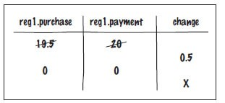
Self Check 3.23
Consider a CashRegister object reg1 whose payment instance variable has the value 20 and whose purchase instance variable has the value 19.5. Trace the call reg1.giveChange(). Include the local variable change. Draw an X in its column when the variable ceases to exist.
Answer:

Slide 77
The this Reference
Two types of inputs are passed when a method is called:
The object on which you invoke the method The method arguments
In the call momsSavings.deposit(500) the method needs to know:
The account object (momsSavings) The amount being deposited (500)
The implicit parameter of a method is the object on which the method is invoked.
All other parameter variables are called explicit parameters.

Slide 78
The this Reference
Look at this method:
amount is the explicit parameter
The implicit parameter(momSavings) is not seen
balance means momSavings.balance
When you refer to an instance variable inside a method, it means the instance variable of the implicit parameter.
public void deposit(double amount)
{
balance = balance + amount;
}

Slide 79
The this Reference
The this reference denotes the implicit parameter
balance = balance + amount;
actually means
this.balance = this.balance + amount;
When you refer to an instance variable in a method, the compiler automatically applies it to the this reference.

Slide 80
The this Reference
Some programmers feel that inserting the this reference before every instance variable reference makes the code clearer:
public BankAccount(double initialBalance)
{
this.balance = initialBalance;
}

Slide 81
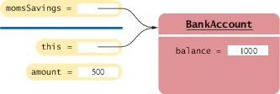
The this Reference
Figure 7 The Implicit Parameter of a Method Call

Slide 82
The this Reference
The this reference can be used to distinguish between instance variables and local or parameter variables:
A local variable shadows an instance variable with the same name.
You can access the instance variable name through the this reference.
In Java, local and parameter variables are considered first when looking up variable names.
Statement
public BankAccount(double balance)
{
this.balance = balance;
}
this.balance = balance;
means: "Set the instance variable balance to the parameter variable balance".

Slide 83
The this Reference
A method call without an implicit parameter is applied to the same object.
Example:
public class BankAccount
{
. . .
public void monthlyFee()
{
withdraw(10); // Withdraw $10 from this account
}
}
The implicit parameter of the withdraw method is the (invisible) implicit parameter of the monthlyFee method
You can use the this reference to make the method easier to read:
public class BankAccount
{
. . .
public void monthlyFee()
{
this.withdraw(10); // Withdraw $10 from this account
}
}

Slide 84
Self Check 3.24
How many implicit and explicit parameters does the withdraw method of the
BankAccount class have, and what are their names and types?
Answer: One implicit parameter, called this, of type BankAccount, and one explicit parameter, called amount, of type double.

Slide 85
Self Check 3.25
In the deposit method, what is the meaning of this.amount? Or, if the expression has no meaning, why not?
Answer: It is not a legal expression. this is of type BankAccount and the BankAccount class has no instance variable named amount.

Slide 86
Self Check 3.26
How many implicit and explicit parameters does the main method of the
BankAccountTester class have, and what are they called?
Answer: No implicit parameter — the main method is not invoked on any object — and one explicit parameter, called args.

Slide 87
Shape Classes
Good practice: Make a class for each part of a drawing that occurs more than once.
public class Car
{
public Car(int x, int y)
{
// Remember position
. . .
}
public void draw(Graphics2D g2)
{
// Drawing instructions
. . .
}
}

Slide 88
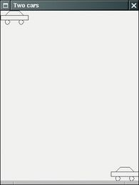
Drawing Cars
Goal: draw two cars - one in top-left corner of window, and another in the bottom right.
Figure 8 The Car Component Draws Two Car Shapes

Slide 89
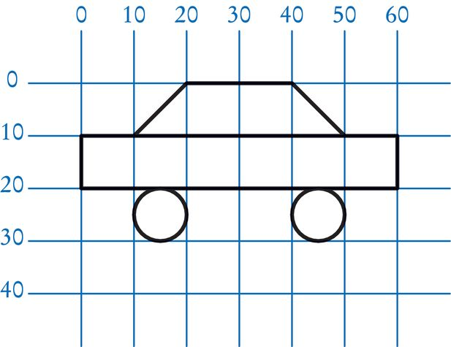
Plan Complex Shapes on Graph Paper
Figure 9 Using Graph Paper to Find Shape Coordinates

Slide 90
Drawing Cars
The program that produces the drawing is composed of three classes:
The Car class is responsible for drawing a single car.
Two objects of this class are constructed, one for each car.
The CarComponent class displays the drawing.
The CarViewer class shows a frame that contains a
CarComponent.

Slide 91
Drawing Cars
The paintComponent method of the CarComponent class draws the two cars.
To compute bottom right position:
Car car1 = new Car(0, 0); int x = getWidth() - 60; int y = getHeight() - 30; Car car2 = new Car(x, y);
getWidth and getHeight return the dimensions of the CarComponent Subtract the dimensions of the car to determine the position of car2:
When window is resized
paintComponent is called
car position is recomputed using current dimensions

Slide 92
section_8/Car.java
1 | import java.awt.Graphics2D;
2 | import java.awt.Rectangle;
3 | import java.awt.geom.Ellipse2D;
4 | import java.awt.geom.Line2D;
5 | import java.awt.geom.Point2D;
6
7 | /**
8 | A car shape that can be positioned anywhere on the screen.
9 | */
10 | public class Car
11 | {
12 | private int xLeft;
13 | private int yTop;
14
15 | /**
16 | Constructs a car with a given top left corner.
17 | @param x the x coordinate of the top left corner
18 | @param y the y coordinate of the top left corner
19 | */
20 | public Car(int x, int y)
21 | {
22 | xLeft = x;
23 | yTop = y;
24 | }
25
26 | /**
27 | Draws the car.
28 | @param g2 the graphics context
29 | */
30 | public void draw(Graphics2D g2)
31 | {
32 | Rectangle body = new Rectangle(xLeft, yTop + 10, | 60, 10);
33 | Ellipse2D.Double frontTire
34 | = new Ellipse2D.Double(xLeft + 10, yTop + 20, | 10, 10);
35 | Ellipse2D.Double rearTire

Slide 93
section_8/CarComponent.java
1 import java.awt.Graphics;
2 import java.awt.Graphics2D;
3 import javax.swing.JComponent;
4
5 /**
6 This component draws two car shapes.
7 */
8 public class CarComponent extends JComponent
9 {
10 public void paintComponent(Graphics g)
11 {
12 Graphics2D g2 = (Graphics2D) g;
13
14 Car car1 = new Car(0, 0);
15
16 int x = getWidth() - 60;
17 int y = getHeight() - 30;
18
19 Car car2 = new Car(x, y);
20
21 car1.draw(g2);
22 car2.draw(g2);
23 }
24 }

Slide 94
section_8/CarViewer.java
1 import javax.swing.JFrame;
2
3 public class CarViewer
4 {
5 public static void main(String[] args)
6 {
7 JFrame frame = new JFrame();
8
9 frame.setSize(300, 400);
10 frame.setTitle("Two cars");
11 frame.setDefaultCloseOperation(JFrame.EXIT_ON_CLOSE);
12
13 CarComponent component = new CarComponent();
14 frame.add(component);
15
16 frame.setVisible(true);
17 }
18 }

Slide 95
Self Check 3.27
Which class needs to be modified to have the two cars positioned next to each other?
Answer: CarComponent

Slide 96
Self Check 3.28
Which class needs to be modified to have the car tires painted in black, and what modification do you need to make?
Answer: In the draw method of the Car class, call
g2.fill(frontTire); g2.fill(rearTire);

Slide 97
Self Check 3.29
How do you make the cars twice as big?
Answer: Double all measurements in the draw method of the Car
class.

